Slide 1
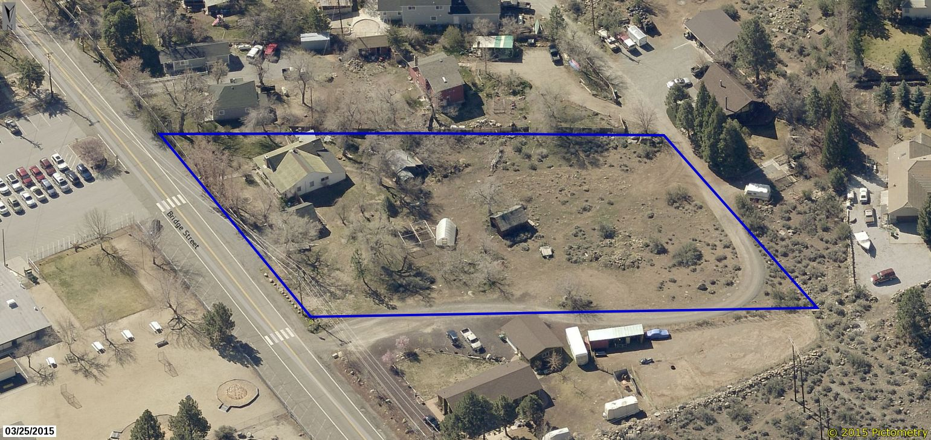
WADMIN17-0003 (Powning DAS)
Washoe County Board of Adjustment
June 1, 2017

Slide 2
Background
Proposal to construct a 4,000 square foot detached accessory structure (DAS)
Existing main dwelling is 1,310 square feet
Per WCC section 110.306.10(d), an Administrative Permit is required to construct a DAS larger than the main dwelling
Metal building to be used for storage and family hobbies; connected to electrical but no plumbing

Slide 3
Background
Subject property is 1.61 acres located off of Bridge Street in Verdi (across from Verdi Elementary)
Surrounding properties are of similar size & zoning
Large detached accessory structures are relatively common in this neighborhood
Proposed location is in the center of the lot
Will replace existing deteriorated structures and enclose a parked trailer

Slide 4
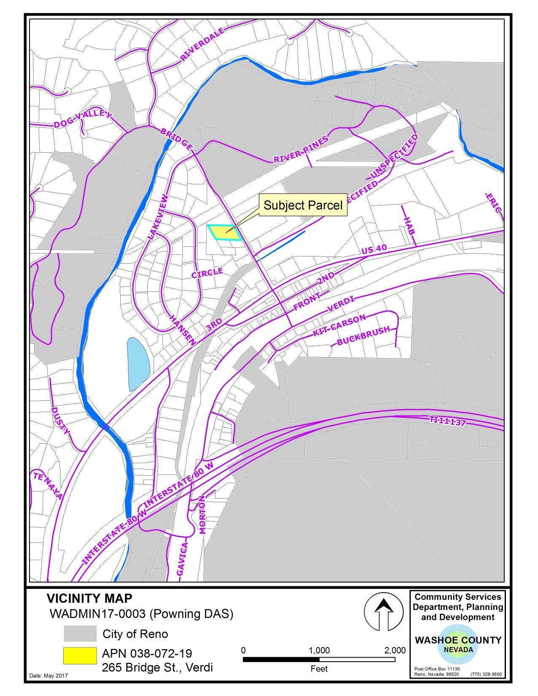

Slide 5
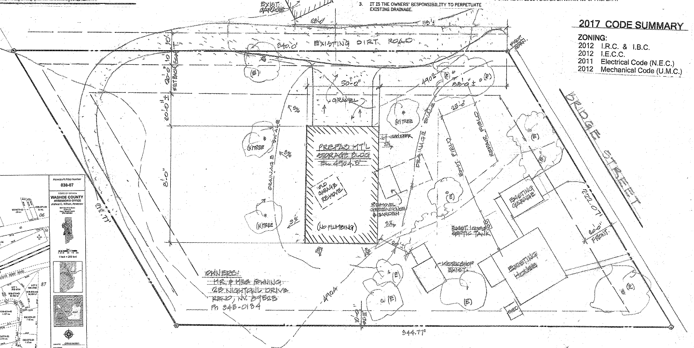
Site Plan

Slide 6
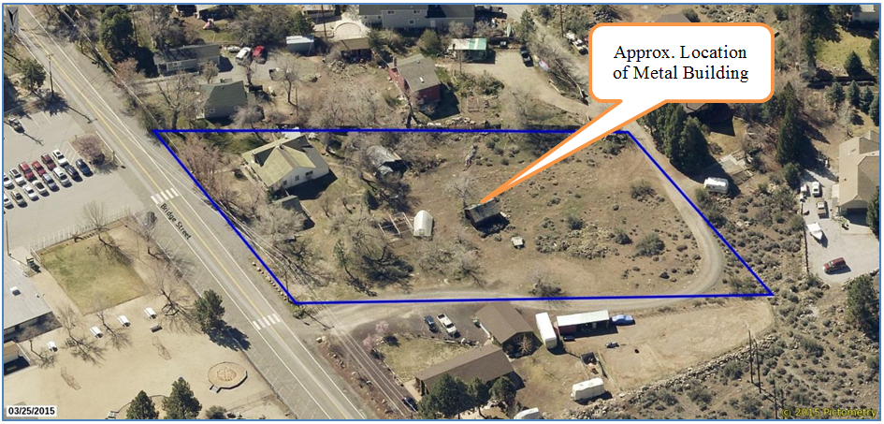
Site Plan

Slide 7
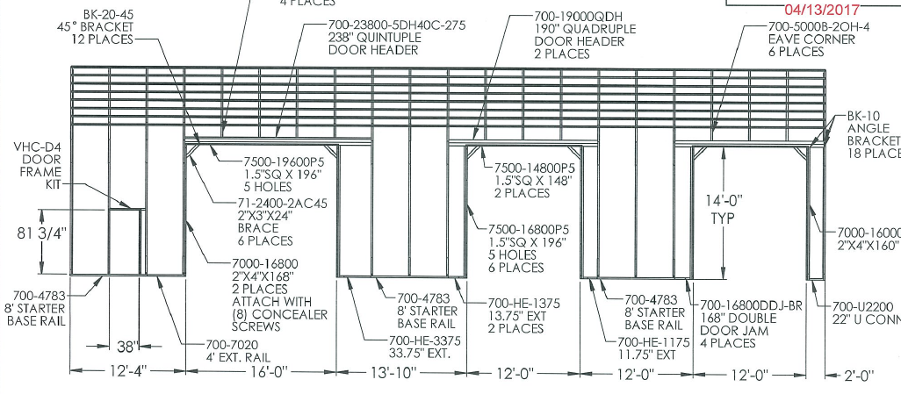
Elevations

Slide 8
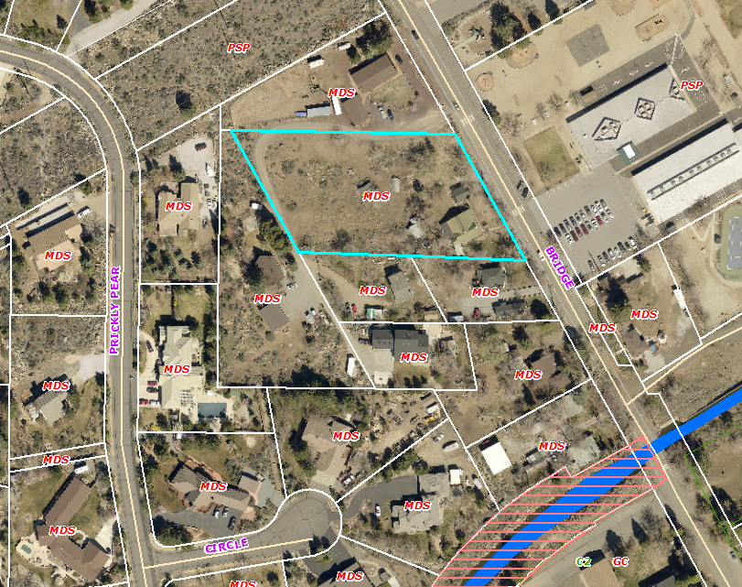
Adjacent Uses and Zoning

Slide 9
Analysis
Structure complies with required setbacks (20’ F/R; 8’ S)
Complies with height limitations (~20’ building height, max allowed is 35’)
Minimal grading will be necessary (site is flat)
Does not block any significant views
No reflective materials – building will be painted light gray and trees planted to screen west facing side

Slide 10
Reviewing Agencies
No comments were received from reviewing agencies
See Exhibit A of the staff report for the recommended conditions of approval

Slide 11
Citizen Advisory Board/Public Comment
The West Truckee Meadows/Verdi Citizen Advisory Board did not have a meeting
The application was distributed to CAB members for their review and comment
Staff has not received any comments from CAB members
Staff has not received any comments or objections from adjacent neighbors

Slide 12
Required Findings
WCC Section 110.808.25, Administrative Permits:
Consistency with Master Plans
Improvements – adequate infrastructure has been provided or is available
Site Suitability
Issuance Not Detrimental
Effect on Military Installation)

Slide 13
Required Findings
Staff analysis of required findings is provided in the staff report starting on page 9
Staff is able to make all of the required findings

Slide 14
Staff Recommendation
After a thorough analysis and review, Administrative Permit Case Number WADMIN17-0003 is being recommended for approval with conditions. Staff offers the following motion for the Board’s consideration.

Slide 15
Possible Motion
I move that, after giving reasoned consideration to the information contained in the staff report and information received during the public hearing, the Board of Adjustment approve Administrative Permit Case Number WADMIN17-0003 for the Powning Family Trust, with the conditions of approval included as Exhibit A to this matter, having made all four findings in accordance with Washoe County Code Section 110.808.25, and consistency with the Verdi Area Plan.

Slide 16
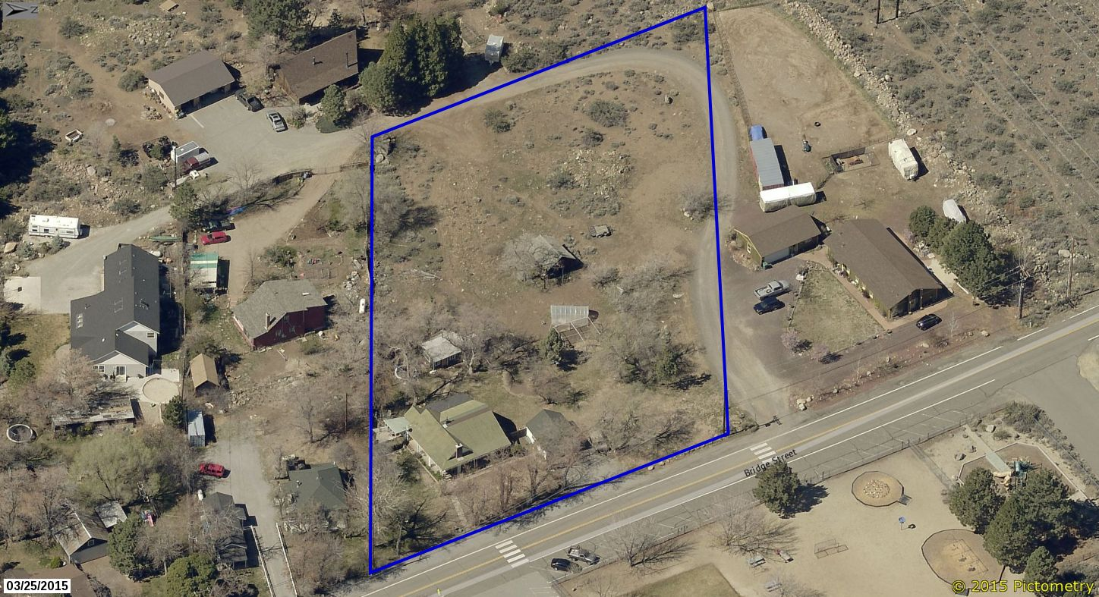
QUESTIONS?

